Slide 1
Clustering

Slide 2
Clustering
Clustering is the process of grouping the data into classes or clusters, so that objects within a cluster have high similarity in comparison to one another but are very dissimilar to objects in other clusters.
Also called Unsupervised learning: no predefined classes

Slide 3
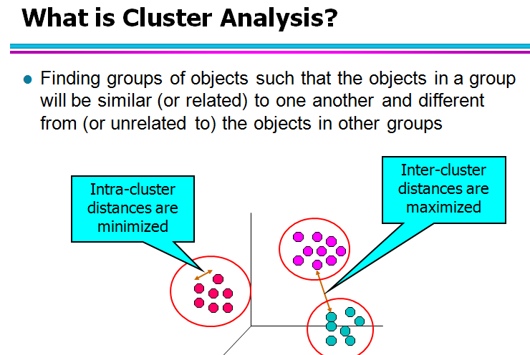

Slide 4
Clustering Applications
Biology: taxonomy of living things: kingdom, phylum, class, order, family, genus and species
Information retrieval: document clustering
Land use: Identification of areas of similar land use in an earth observation database
Marketing: Help marketers discover distinct groups in their customer bases, and then use this knowledge to develop targeted marketing programs
City-planning: Identifying groups of houses according to their house type, value, and geographical location
Earth-quake studies: Observed earth quake epicenters should be clustered along continent faults
Climate: understanding earth climate, find patterns of atmospheric and ocean

Slide 5
Quality: What Is Good Clustering?
A good clustering method will produce high quality clusters
high intra-class similarity: cohesive within clusters
low inter-class similarity: distinctive between clusters

Slide 6
clustering techniques, organized into the following categories:
Partitioning methods
hierarchical methods
density-based method
grid-based methods
model-based methods
methods for high-dimensional data (such as frequent pattern– based methods)
constraint-based clustering.

Slide 7
Major Clustering Approaches
Partitioning methods:
the k-means algorithm
the k-medoid algorithm
Density-based methods:
DBSCAN
OPTICS
DENCLUE

Slide 8
Partitioning Methods
Given D, a data set of n objects, and k, the number of clusters to form, a partitioning algorithm organizes the objects into k partitions (k n), where each partition represents a cluster.
Classical Partitioning Methods: k-Means and k-Medoids

Slide 9
Centroid-Based Technique: The k-Means Method
The k-means algorithm takes the input parameter, k, and partitions a set of n objects into k clusters so that the resulting intracluster similarity is high but the intercluster similarity is low.
Cluster similarity is measured in regard to the mean value of the objects in a cluster, which can be viewed as the cluster’s centroid or center of gravity.

Slide 10
k-means algorithm working
First, it randomly selects k of the objects, each of which initially represents a cluster mean or center.
For each of the remaining objects, an object is assigned to the cluster to which it is the most similar, based on the distance between the object and the cluster mean.
It then computes the new mean for each cluster.
This process iterates until the criterion function converges.

Slide 11
Algorithm- K means clustering
Specify the value of k,ie the number of clusters to be formed
Select k points at random as cluster centers.
Assign objects to their closest cluster center according to the Euclidean distance function.
Calculate the centroid or mean of all objects in each cluster.
Repeat steps 2, 3 and 4 until the same points are assigned to each cluster in consecutive rounds.

Slide 12
Example of K means clustering for one dimensional data
We will apply k-means on the following 1 dimensional data set for K=2.
Data set {2, 4, 10, 12, 3, 20, 30, 11, 25}

Slide 13
Example of K means clustering for one dimensional data
Iteration 1
M1, M2 are the two randomly selected centroids where M1= 4, M2=11
and the initial clusters are C1= {4}, C2= {11}
Calculate the Euclidean distance as
Distance 1(D1)=|xi-c1|
Distance 2(D2)=|xi-c2|,Where xi is the data point.
D1 is the distance from C1
D2 is the distance from C2

Slide 14
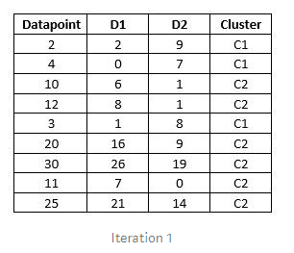
Iteration 1
(4)
(11)
As we can see in the above table, 2 datapoints are added to cluster C1 and other datapoints added to cluster C2
Therefore
C1= {2, 4, 3}
C2= {10, 12, 20, 30, 11, 25}

Slide 15
Now, We re-compute the new cluster clusters. The new cluster center is computed by taking mean of all the points contained in that cluster.
Calculate new mean of datapoints in C1 and C2.
Therefore
M1= (2+3+4)/3= 3
M2= (10+12+20+30+11+25)/6= 18
Calculating distance and updating clusters based on table below

Slide 16
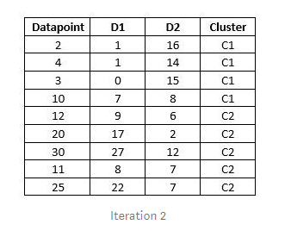
Iteration 2
(3)
(18)
New Clusters
C1= {2, 3, 4, 10}
C2= {12, 20, 30, 11, 25}

Slide 17
Now, We re-compute the new cluster clusters. The new cluster center is computed by taking mean of all the points contained in that cluster.
Calculate new mean of datapoints in C1 and C2.
Therefore
M1= (2+3+4+10)/4= 4.75
M2= (12+20+30+11+25)/5= 19.6
Calculating distance and updating clusters based on table below

Slide 18
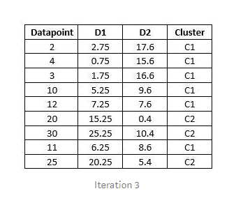
Iteration 3
4.75
19.6
New Clusters
C1= {2, 3, 4, 10, 12, 11}
C2= {20, 30, 25}

Slide 19
Now, We re-compute the new cluster clusters. The new cluster center is computed by taking mean of all the points contained in that cluster
Calculate new mean of data points in C1 and C2.
Therefore
M1= (2+3+4+10+12+11)/6=7
M2= (20+30+25)/3= 25
Calculating distance and updating clusters based on table below

Slide 20
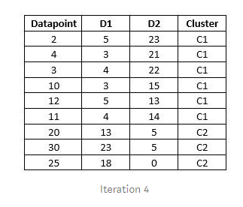
Iteration 4
7
25
New Clusters
C1= {2, 3, 4, 10, 12, 11}
C2= {20, 30, 25}
As we can see that the data points in the cluster C1 and C2 in iteration 3 are same as the data points of the cluster C1 and C2 of iteration 2.
It means that none of the data points has moved to other cluster. Also the means/centeroid of these clusters is constant. So this becomes the stopping condition for our algorithm.

Slide 21
Example of K means clustering for one dimensional data
Example:Suppose we want to group the visitors to a website using just their age (one-dimensional space) as follows:n = 19
15,15,16,19,19,20,20,21,22,28,35,40,41,42,43,44,60,61,65
Initial clusters (random centroid or average):k = 2
c₁ = 16 c₂ = 22
Distance 1=|xi-c1|
Distance 2=|xi-c2|

Slide 22
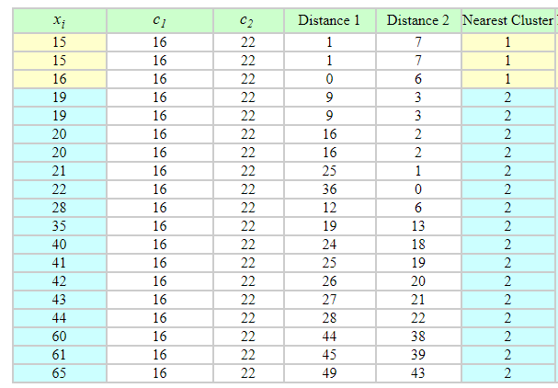
Iteration 1:
After first iteration new centroids are
c₁ = 15.33(15+15+16/3) c₂ = 36.25

Slide 23
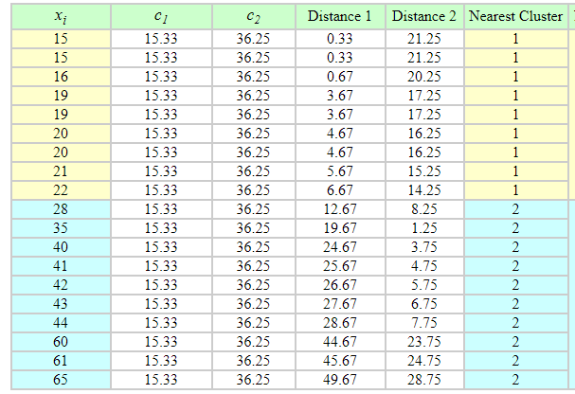
Iteration 2:
After second iteration new centroids are
c₁ = 18.56 c₂ = 45.90

Slide 24
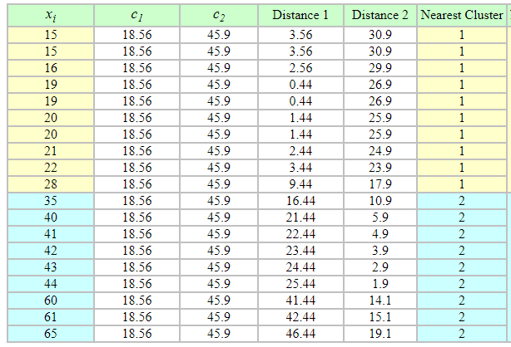
Iteration 3:
After third iteration new centroids are
c₁ = 19.50 c₂ = 47.89

Slide 25
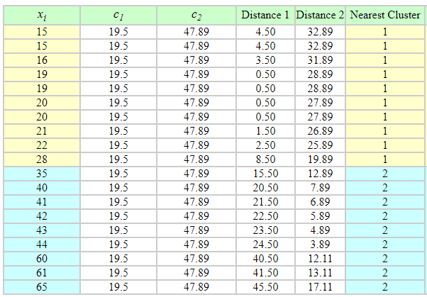
Iteration 4:
After fourth iteration new centroids are
c₁ = 19.50 c₂ = 47.89

Slide 26
No change between iterations 3 and 4 has been noted.
By using clustering, 2 groups have been identified 15-28 and 35-65.
The initial choice of centroids can affect the output clusters, so the algorithm is often run multiple times with different starting conditions in order to get a fair view of what the clusters should be.

Slide 27
Example of K means clustering for two dimensional data
Use the k-means algorithm and Euclidean distance to cluster the following 8 examples into 3 clusters:
A1=(2,10)
A2=(2,5)
A3=(8,4)
A4=(5,8)
A5=(7,5),
A6=(6,4)
A7=(1,2)
A8=(4,9).
Suppose that the initial seeds (centers of each cluster) are A1, A4 and A7.

Slide 28
Solution:
d(a,b) denotes the Eucledian distance between a and b.
It is obtained directly from the distance matrix or calculated as follows:
If (x1,y1) and (x2,y2) are the two points ,then the distance between the two points are calculated as
d(a,b)=sqrt((x2-x1) 2 +(y2-y1) 2 ))

Slide 29
Initial cluster centroid
Cluster1 (C1)=A1=(2,10)
Cluster2 (C2)=A4=(5,8)
Cluster3 (C3)=A7=(1,2)

Slide 30
Iteration 1 – Epoch 1
First data point A1
Find the distance of A1 to C1,C2,C3
(i) d(A1,C1)
(ii) d(A1,C2)
(iii) d(A1,C3)

Slide 31
Iteration 1 – Epoch 1
First data point A1
(i) d(A1,C1) = 0

Slide 32
Iteration 1 – Epoch 1
First data point A1
(ii) d(A1,C2)= d[(2,10),(5,8)]
=√ (5-2)² +(8-10)²
=√ 3² + (-2)²
=√ 9+4
=√ 13
=3.6

Slide 33
Iteration 1 – Epoch 1
First data point A1
(iii) d(A1,C3)= d[(2,10),(1,2)]
=√ (1-2)² +(2-10)²
=√ 65
=8.06

Slide 34
Iteration 1 – Epoch 1
Data point A1
d(A1,C1) = 0
d(A1,C2)=3.6
d(A1,C3)= 8.06
Here smallest distance is 0, so the data point A1 belongs to cluster C1

Slide 35
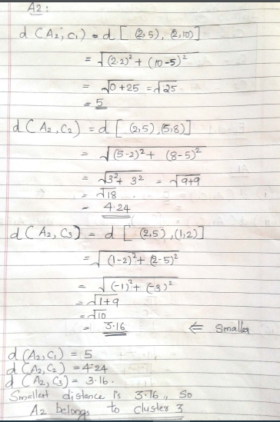

Slide 36
Iteration 1 – Epoch 1
Data point A2
d(A2,C1) = 5
d(A2,C2)=4.24
d(A2,C3)= 3.16
^{Here smallest distance is} 3.16, so the data point A2 belongs to cluster 3

Slide 37
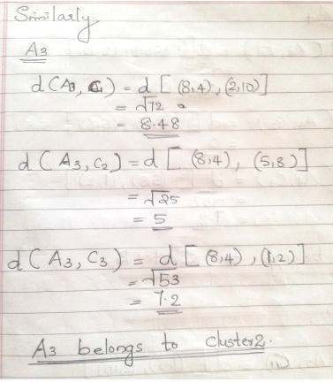

Slide 38
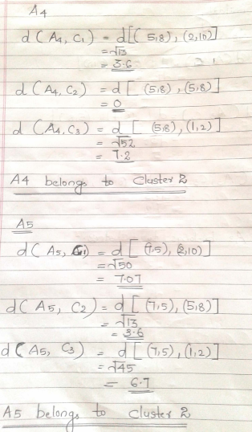

Slide 39
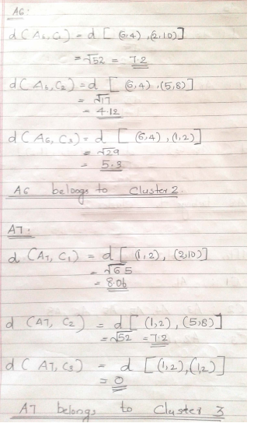

Slide 40
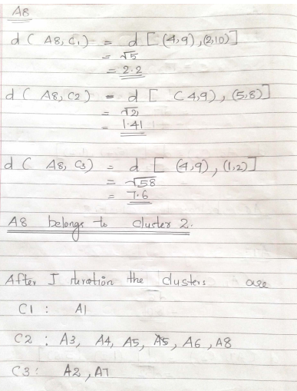

Slide 41
After first iterations the clusters are
C1 : A1
C2 : A3,A4,A5,A6,A8
C3 :A2 ,A7

Slide 42
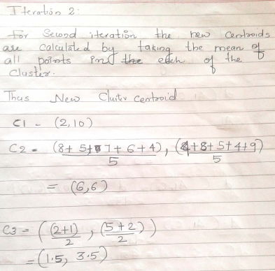

Slide 43
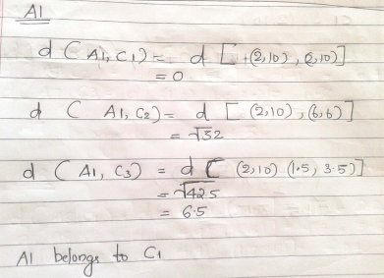

Slide 44
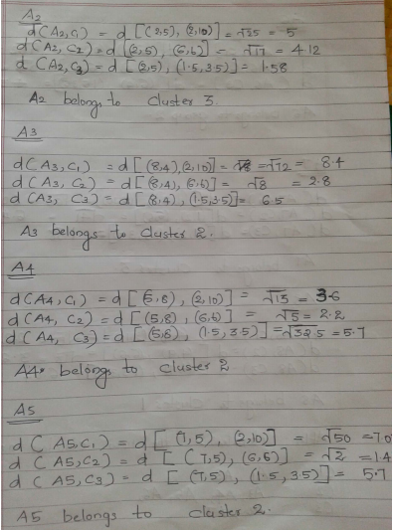

Slide 45
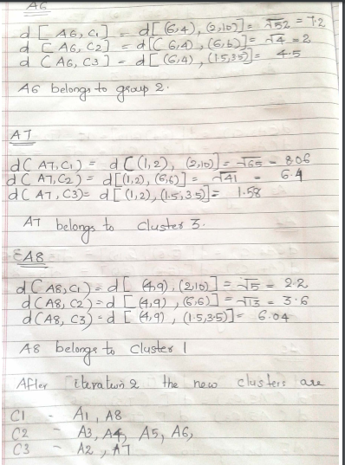

Slide 46
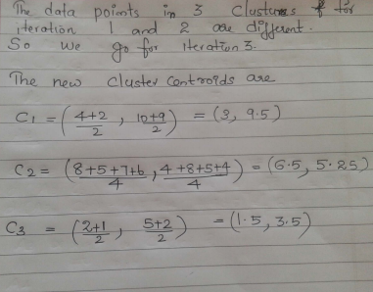

Slide 47
After the 2nd epoch the results would be:
1: {A1, A8}
2: {A3, A4, A5, A6}
3: {A2, A7}
with centers C1=(3, 9.5), C2=(6.5, 5.25) and C3=(1.5, 3.5).
After the 3rd epoch, the results would be:
1: {A1, A4, A8}
2: {A3, A5, A6},
3: {A2, A7}
with centers C1=(3.66, 9), C2=(7, 4.33) and C3=(1.5, 3.5).
After the 4 th epoch, the clusters remain the same ie
1: {A1, A4, A8},
2: {A3, A5, A6},
3: {A2, A7}
with centers C1=(3.66, 9), C2=(7, 4.33) and C3=(1.5, 3.5).
So we stop the iteration and final clusters are
1: {A1, A4, A8},
2: {A3, A5, A6},
3: {A2, A7}

Slide 48
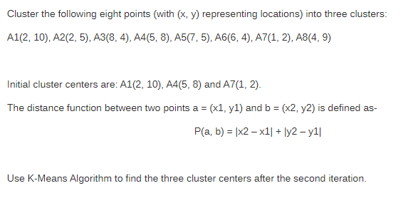
K means clustering - example 2

Slide 49
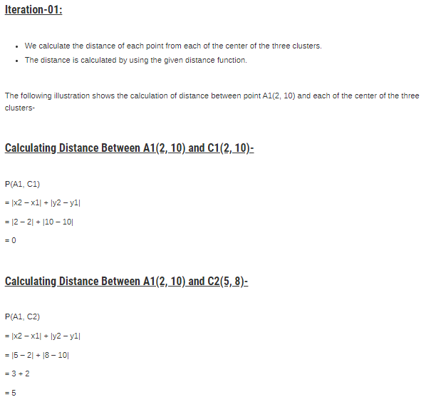

Slide 50
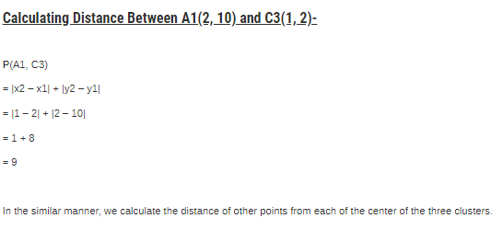

Slide 51
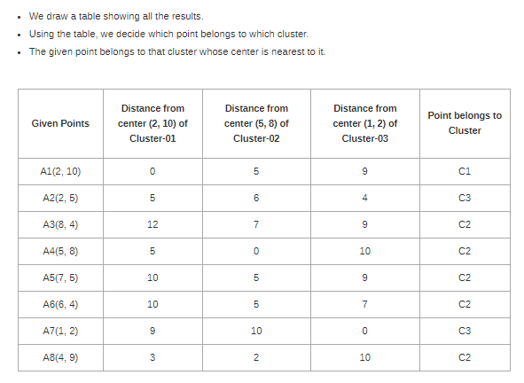

Slide 52
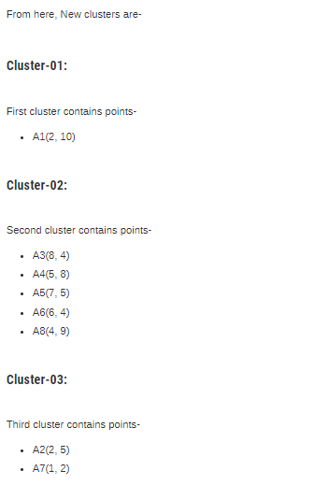

Slide 53
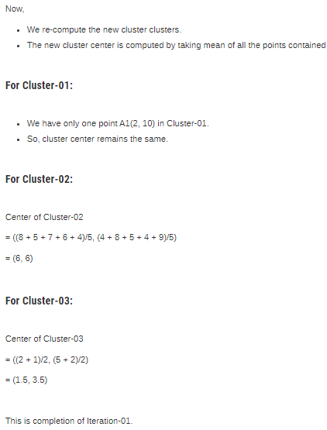

Slide 54
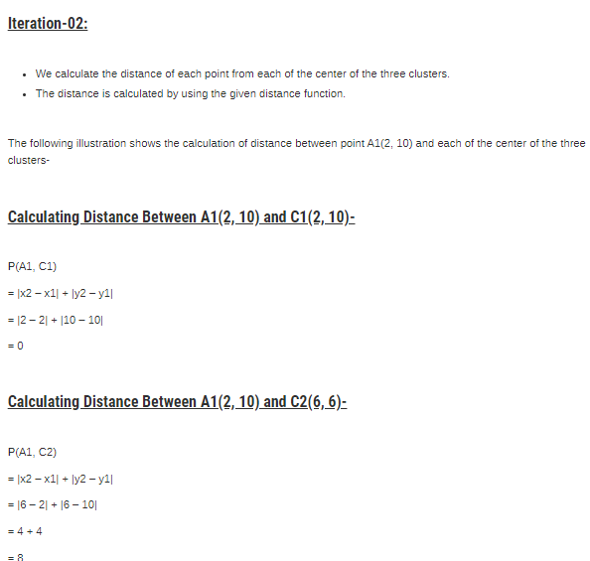

Slide 55
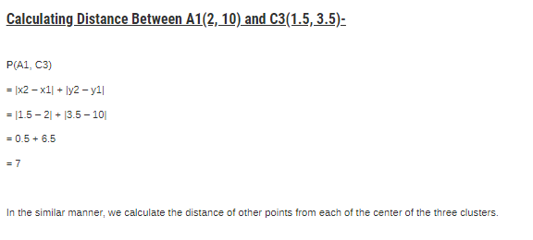

Slide 56
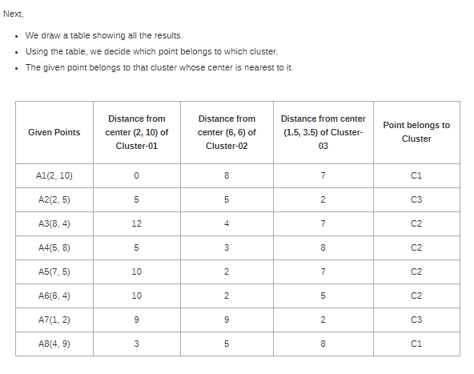

Slide 57
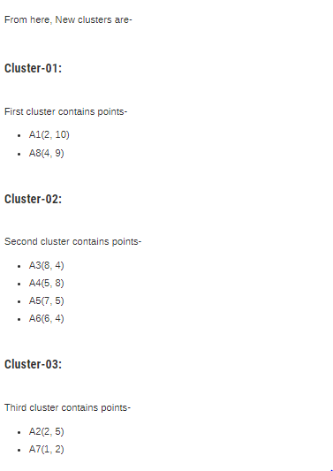

Slide 58
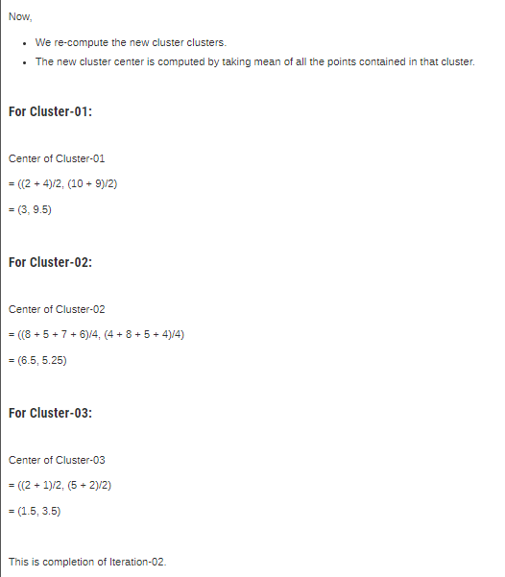

Slide 59


Distance Measures used in k-means
Euclidean Distance
2. Manhattan Distance (City block distance )
Manhattan Distance between two points (x₁, y₁) and (x₂, y₂) is: |x₁ – x₂| + |y₁ – y₂|
3. Chebychev Distance (chessboard distance)\
4. Minkowski Distance

Slide 60
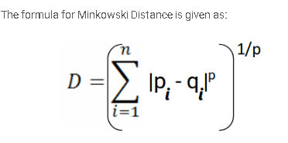
Minkowski Distance
Minkowski Distance is the generalized form of Euclidean and Manhattan Distance.
The case where p = 1 is equivalent to the Manhattan distance and the case where p = 2 is equivalent to the Euclidean distance.

Slide 61
Strength of K-means
The method is relatively scalable and efficient in processing large data sets because the computational complexity of the algorithm is O(nkt), where n is the total number of objects, k is the number of clusters, and t is the number of iter-ations.

Slide 62
Weakness of K-mean
The k-means method, however, can be applied only when the mean of a cluster is defined. This may not be the case in some applications, such as when data with categorical attributes are involved.
The users need to specify k, the number of clusters, in advance
The k-means method is not suitable for discovering clusters with nonconvex shapes or clusters of very different size.
It is sensitive to noise and outlier data points because a small number of such data can substantially influence the mean value.

Slide 63
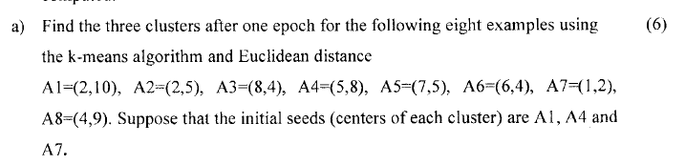
UNIVERSITY QUESTIONS

Slide 64
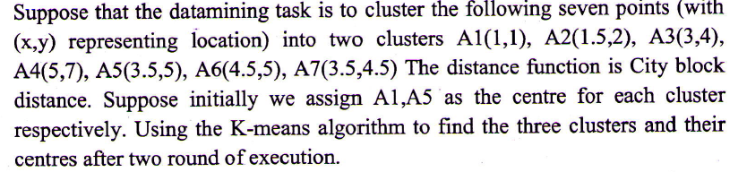
UNIVERSITY QUESTIONS

Slide 65
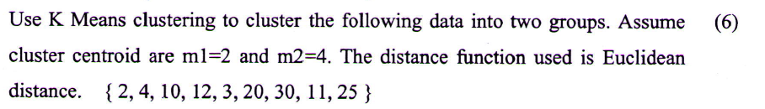
UNIVERSITY QUESTIONS

Slide 66
UNIVERSITY QUESTIONS

